Slide 1
EssyWiki
Jason Johnson, Chris Garrett, Logan Brown

Slide 2
Stage B Meetings
Team members individually compiled user stories for the first meeting, in which we reviewed them and considered which were feasible and which we wanted to implement.
A second meeting was had shortly after in which we ensured we had a plan for at least 5 features, and we also discussed implementation details.
Initial sprint goals were given; we are still in progress for this initial sprint.

Slide 3
User Stories
User Roles
As an administrator I want to control what users have what privileges in the system in order to protect the security of the system.
User Index / User Manager
As an administrator I want to add new users to the system and be able to see users already in the system in order to manage them.
New Markdown Editor
As a contributor I want to write articles without knowledge of markdown so that the bar of entry is lower.

Slide 4
User Stories
Page Categories
As a site visitor I want to see related pages for whatever I’m looking at to make browsing a general category easier.
Edit History
As an administrator I want to see what users are making changes on what pages in order to make decisions about user management and roll back changes

Slide 5
Stage A Plans
Command-line SE book generator
Will make use of page category feature for grouping related topics into chapters potentially
Will make use of any added markdown features used in the new editor

Slide 6
Demo: Building a functional user system
Chris Garrett

Slide 7
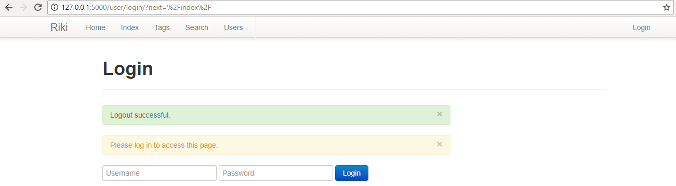
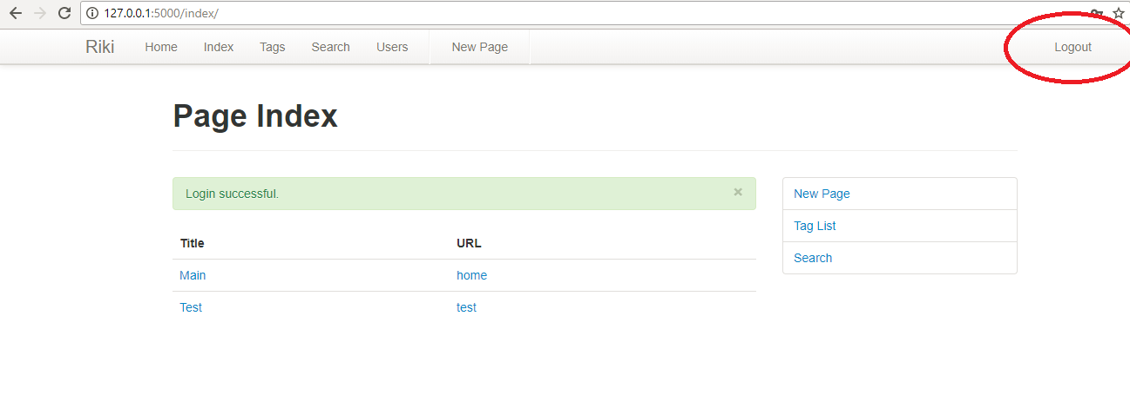
Login/Logout

Slide 8
User Roles
3 levels – admin, contributor, user
Admin is highest level, full access to all features of the wiki
Contributor is next highest – Cannot add users, change user roles, or delete pages
User – Lowest level, cannot create pages

Slide 9
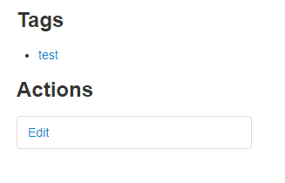
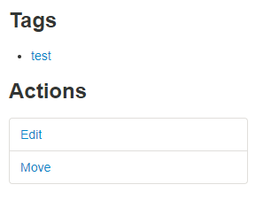
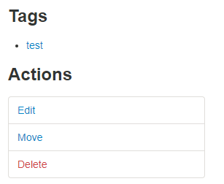
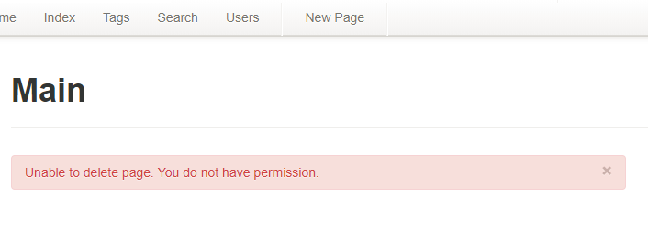
User Roles (Cont.)
User
Contributor
Admin

Slide 10
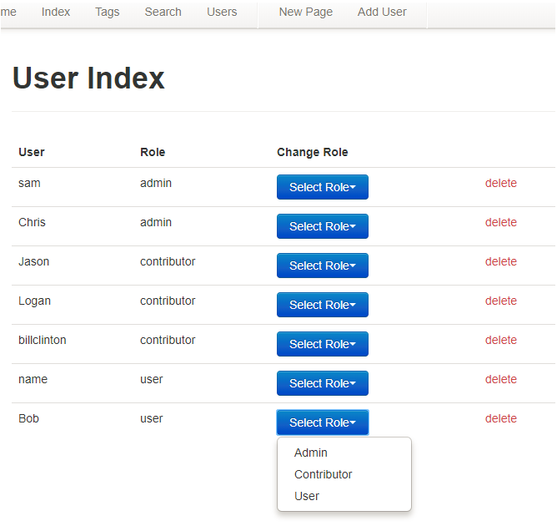
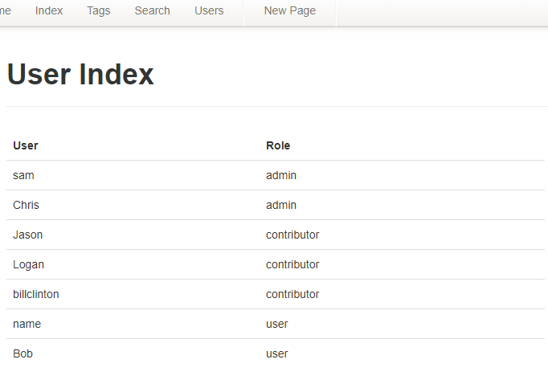
User Index

Slide 11
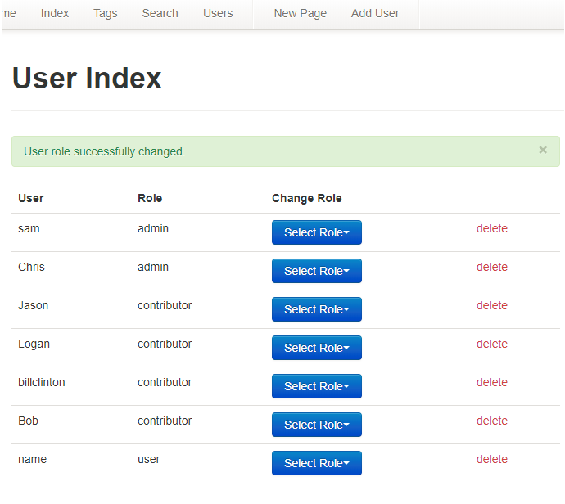
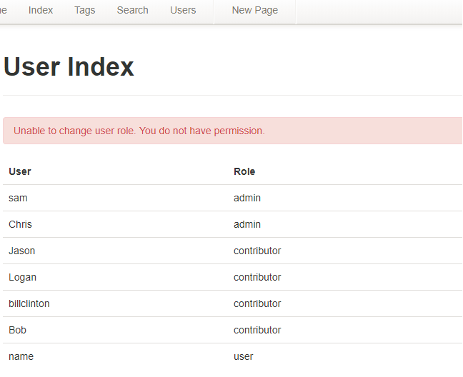
User Index (Cont.)

Slide 12
Process Retrospective
We’re meeting our lowest expectations for our last sprint, but the coordination could use work.
For future sprints (which will have to be short considering time constraints), we will make a point of documenting as we progress so that collaboration can go more smoothly and testing can potentially start sooner.
We’ll also work on a better group understanding even of the features which only one member is assigned to.

